Slide 1

Zero-Shot Learning with Semantic Output Codes
Department of Computer Engineering
Dongseo University
Jie Yong Shin,
2023.02.16
Notes:
1

Slide 2
CONTENTS
Highlights
Zero-Shot Learning
Experimental Results
Conclusion and Discussion
2
Notes:
2

Slide 3
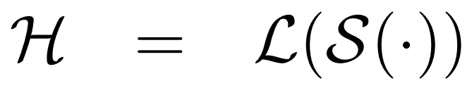
1. Highlights
Why did they develop this?
They wanted to predict a word with a neural activity image.
There are more unlabeled data than labeled data.
How does it work?
Experimental Results of their work.
Possible new ideas related to Zero-Shot Learning.
3
Notes:
3

Slide 4
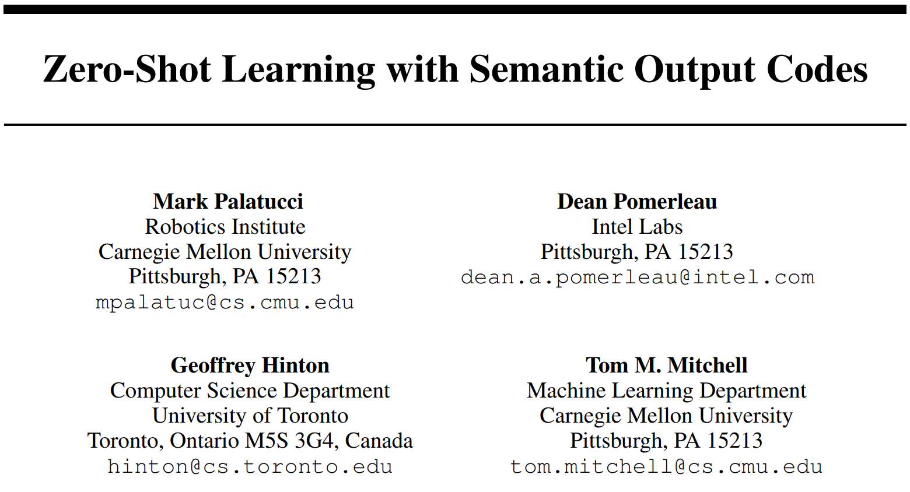
2. Zero-Shot Learning
Published at 2009
4
Notes:
4

Slide 5
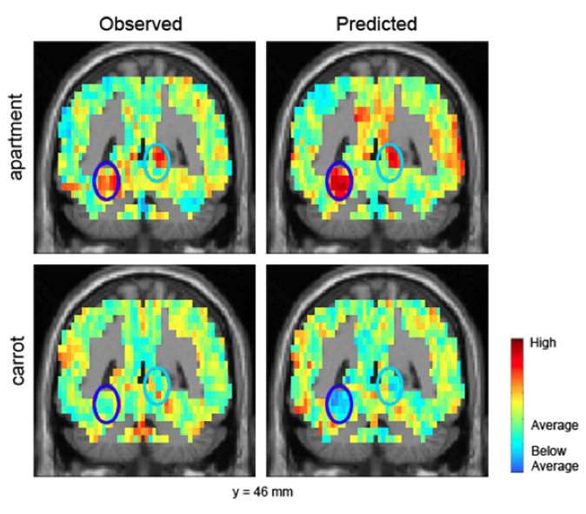
2. Zero-Shot Learning
mri60 (Neural activity dataset with fMRI)
60 different concrete words(5 examples from 12 different categories
ex) Animals: bear, dog, cat, cow, horse
Vehicles: truck, car, train, airplane, bicycle
5
5
A Neurosemantic Theory of Concrete Noun Representation Based on the Underlying Brain Codes
Notes:
5

Slide 6
2. Zero-Shot Learning
Neural activity dataset (fMRI)
fMRI
Word
“Dog”
x
label
6
6
Predicting Human Brain Activity Associated with the Meanings of Nouns
Notes:
6

Slide 7
2. Zero-Shot Learning
Neural activity dataset (fMRI)
fMRI
Word
“Dog”
x
label
Only 60 words are labeled
7
7
Predicting Human Brain Activity Associated with the Meanings of Nouns
Notes:
7

Slide 8
2. Zero-Shot Learning
Human218 (Semantic knowledge base)
Is it manmade?
Can you hold it?
Is it furry?
Does it have a tail?
Can it breathe underwater?
No 0
Yes 1
Yes 1
Yes 1
No 0
Example of a instance “dog”
{0,1,1,1,0}
“dog”
x
y
8
Notes:
8

Slide 9
2. Zero-Shot Learning
Image
Semantic
Feature
Label
{0,1,1,1,0}
dog
60
60
60
9
Notes:
9

Slide 10




2. Zero-Shot Learning
Image
Semantic
Feature
Label
{1,0,1,0,0}
dog
10
Notes:
10

Slide 11
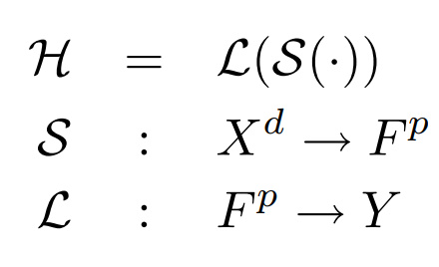
2. Zero-Shot Learning
: Semantic output code classifier
: A collection of linear classifiers
: 1-nearest neighbor classifier
11
Notes:
11

Slide 12





2. Zero-Shot Learning
Training phase
N : number of questions (feature dimension)
M : number of classes
N >> M : class has been expanded to larger space which is feature space.
12
Notes:
12

Slide 13





2. Zero-Shot Learning
Testing phase
S(·) classifies whether the input x has each feature or not.
L(·) clusters where the feature belongs to.
13
Notes:
13

Slide 14
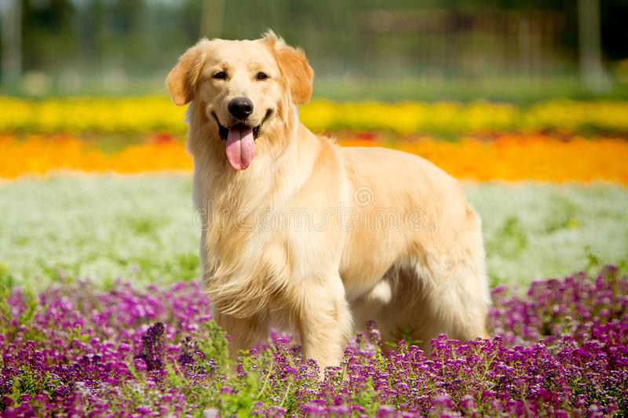




2. Zero-Shot Learning
Example of Testing phase
Image
Semantic
Feature
Label
{0,1,1,1,0}
dog
Manmade?
underwater?
hold?
tail?
furry?
14
Notes:
14

Slide 15
2. Zero-Shot Learning
What they did is :
Image
Semantic
Feature
Label
{0,1,1,1,0}
dog
15
Notes:
15

Slide 16
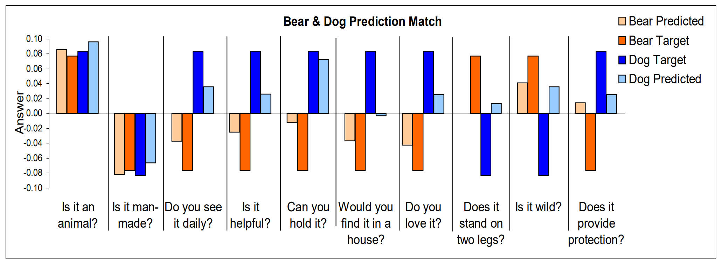
3. Experimental Results
16
Notes:
16

Slide 17
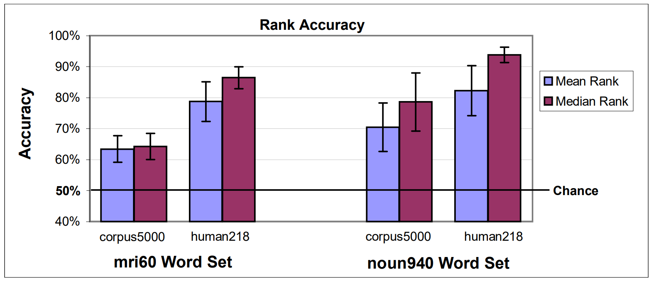
3. Experimental Results
17
Notes:
17

Slide 18
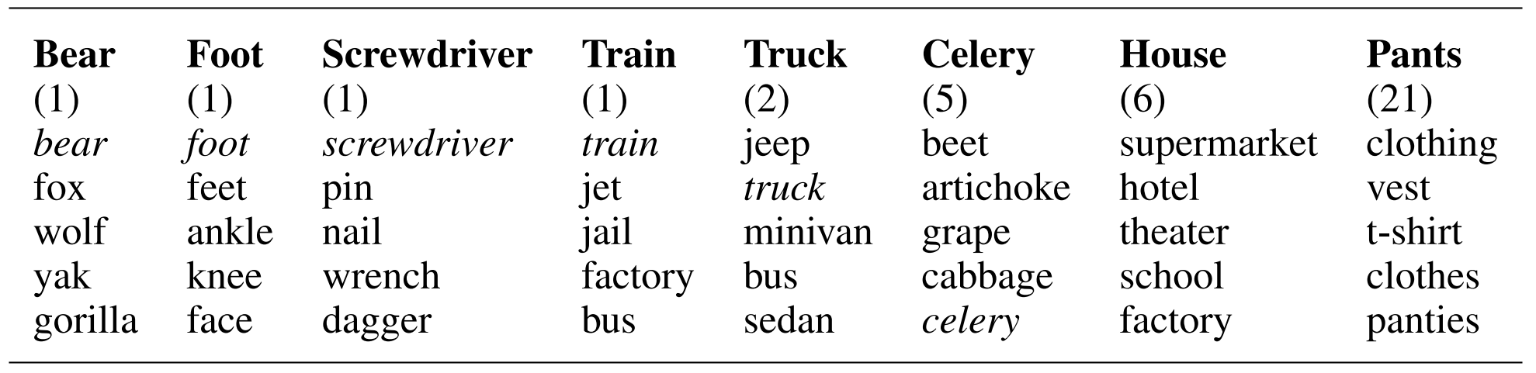
3. Experimental Results
18
Notes:
18

Slide 19
4. Conclusion and Discussion
They have made a model that classifies novel data which have omitted from dataset.
Is it possible to adopt Zero-Shot learning to other areas?
Is it possible to adopt Zero-Shot learning to NAS?
19
Notes:
19

Slide 20
References
Zero-Shot Learning with Semantic Output Codes https://www.cs.toronto.edu/~hinton/absps/palatucci.pdf
A Neurosemantic Theory of Concrete Noun Representation Based on the Underlying Brain Codes https://journals.plos.org/plosone/article?id=10.1371/journal.pone.0008622
An embarrassingly simple approach to zero-shot learning http://proceedings.mlr.press/v37/romera-paredes15.pdf
Zero-Shot Learning -- A Comprehensive Evaluation of the Good, the Bad and the Ugly https://paperswithcode.com/paper/zero-shot-learning-a-comprehensive-evaluation
Zen-NAS: A Zero-Shot NAS for High-Performance Deep Image Recognition https://paperswithcode.com/paper/zen-nas-a-zero-shot-nas-for-high-performance
20
Notes:
20

Slide 21
Thank you
Q & A
Notes:
-
The training of procedure for is to maximize the probability of D making a mistake. This framework corresponds to a minimax two-player game.
In the space of arbitrary functions G and D, a unique solution exists, with G recovering the training data distribution and D equal to ½ everywhere.
21

